Slide 1
HACKATHON PRESENTATION
DS1_BrazilHousing_Hackathon_ARCHIT

Slide 2
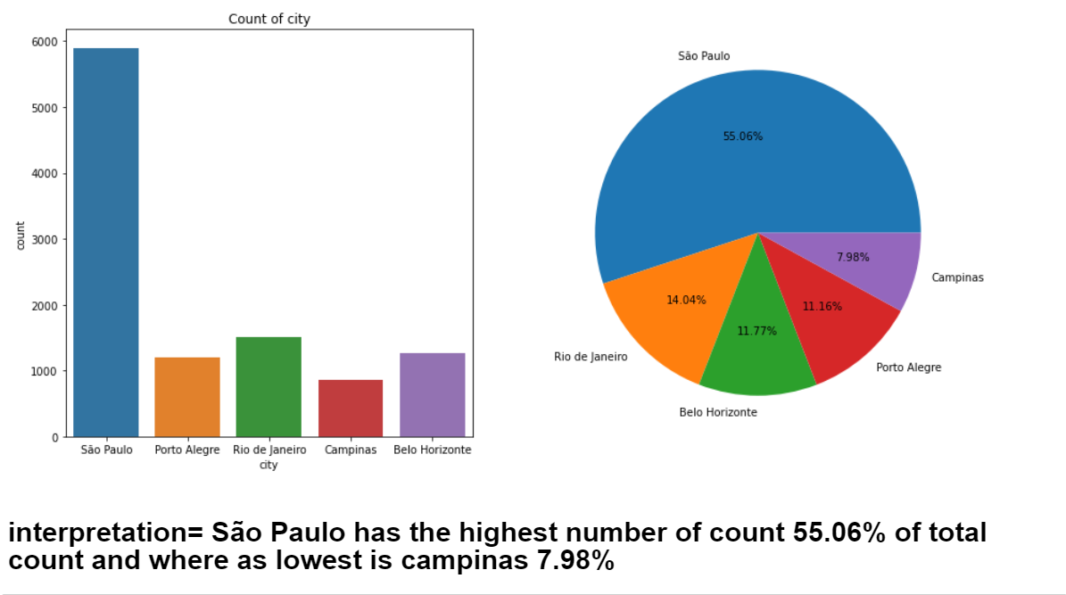
Univariet Categorical :- Column=CITY

Slide 3
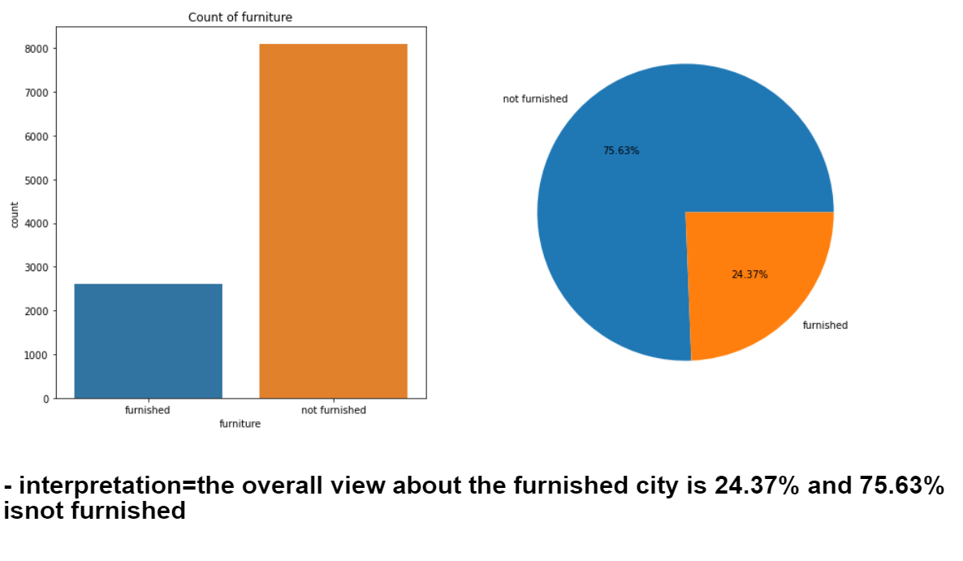
Column=Furniture
The Major part of the city is not having furnished homes!

Slide 4
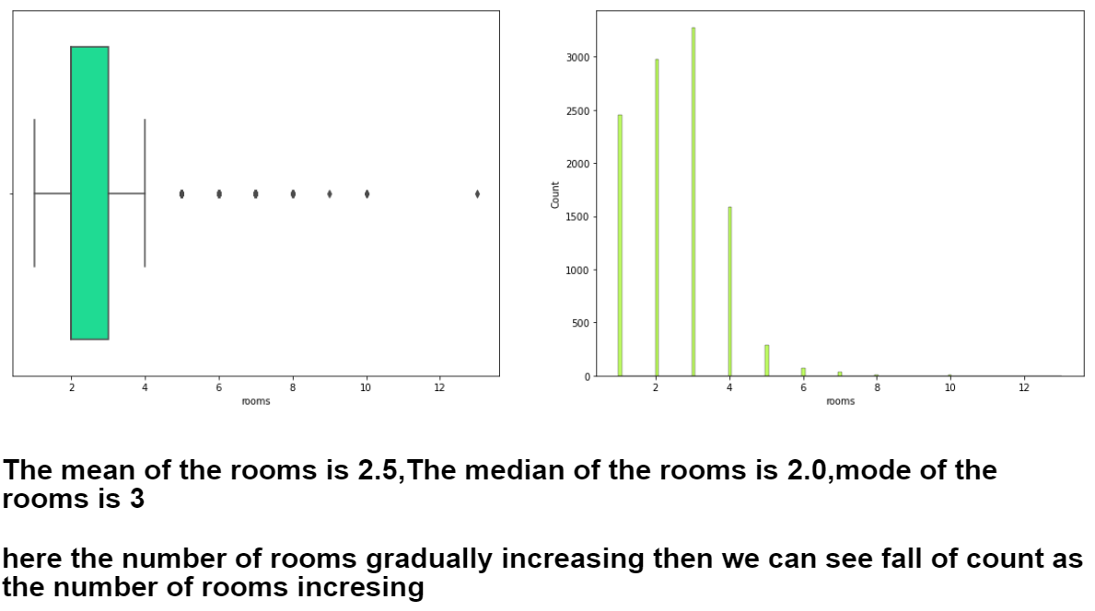
Univariet Numerical column=Rooms

Slide 5
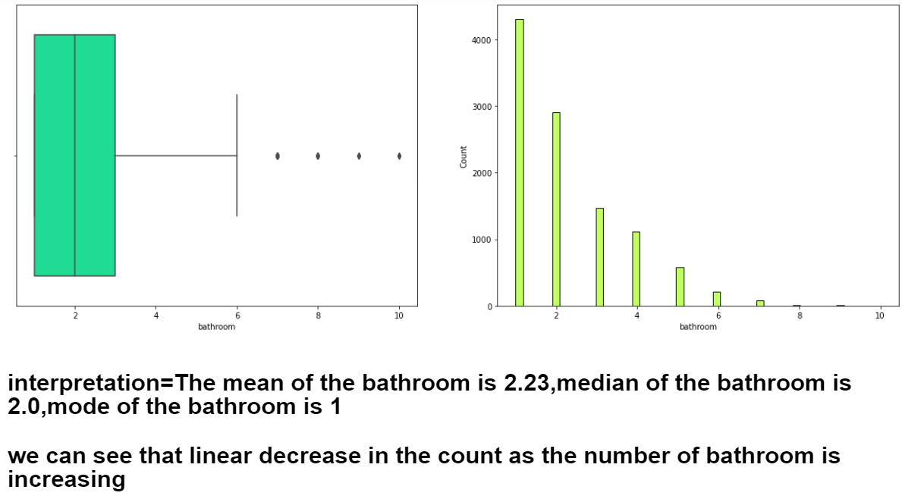
Column=bathroom

Slide 6
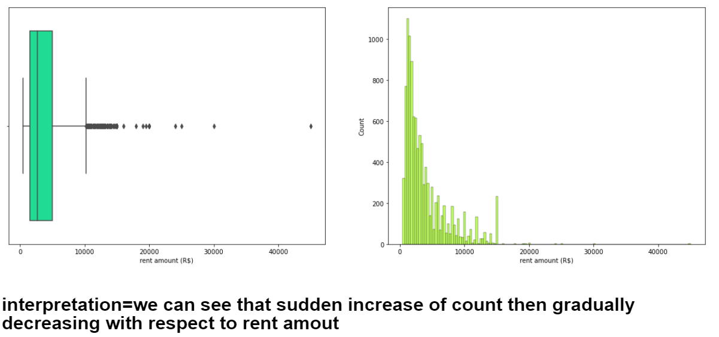
Column=Rent amount (R$)
The Rent Amount is more then the average range!

Slide 7
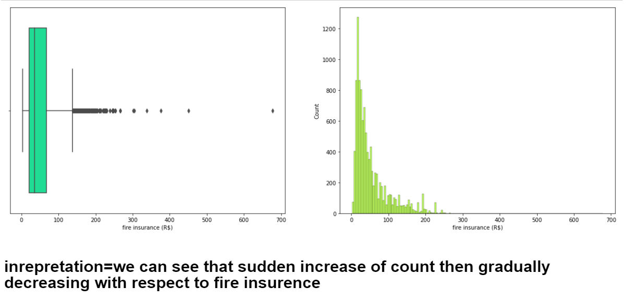
Column=fire insurance (R$)

Slide 8
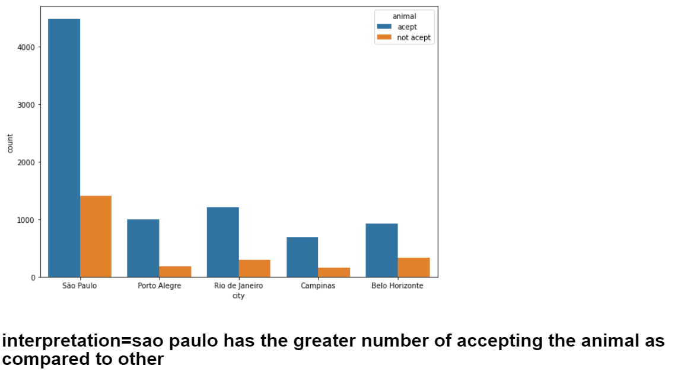
Bivariete cat to cat columns=city and animal
The Sao Paulo City Has the major acceptance level for animals.

Slide 9
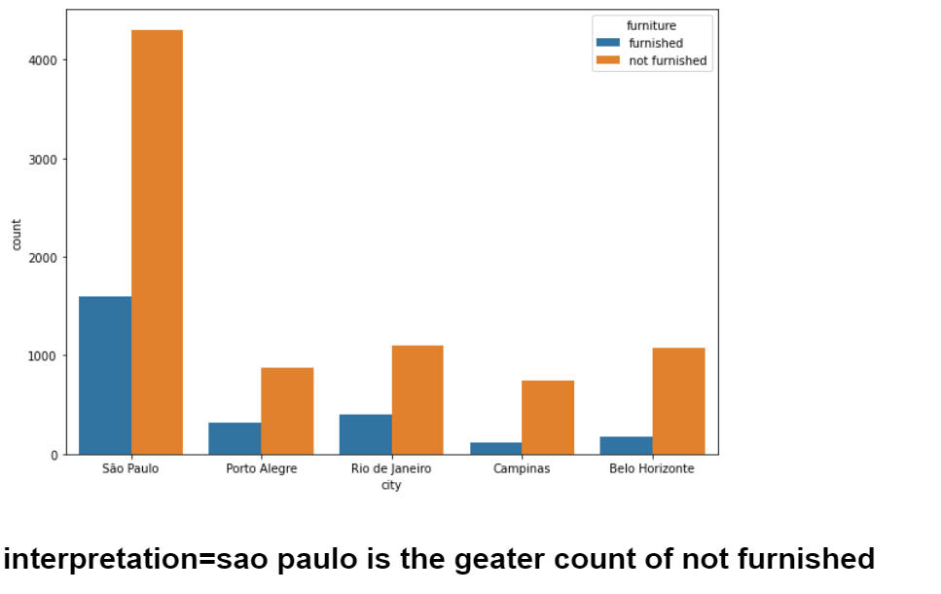
Columns=city to furniture
Comparing to other cities Sao Paulo has more not furnished homes but it also has more furnished home from others.

Slide 10
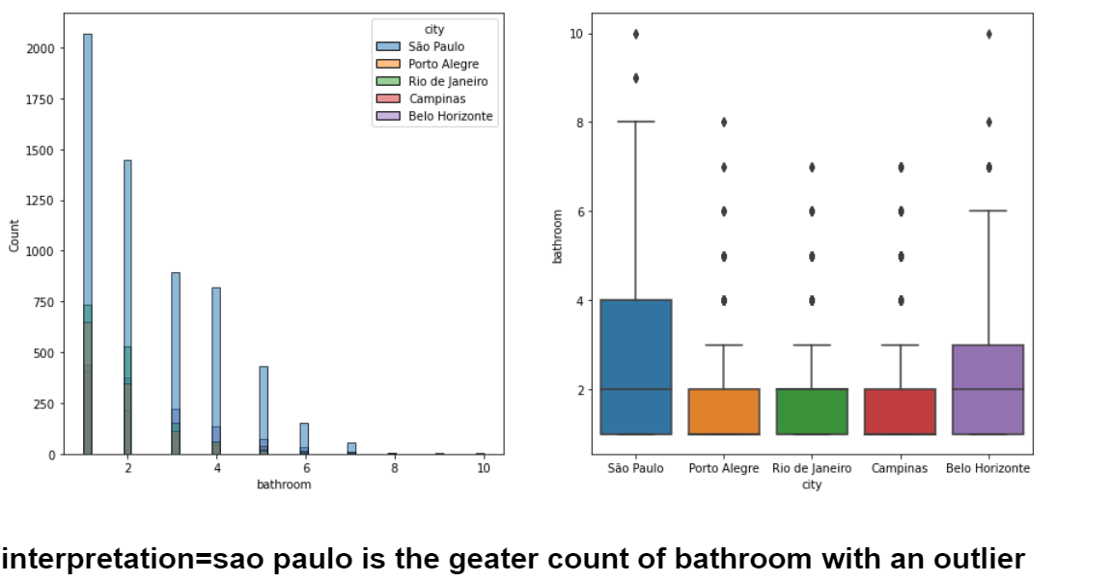
Cat to num columns=city to bathroom

Slide 11
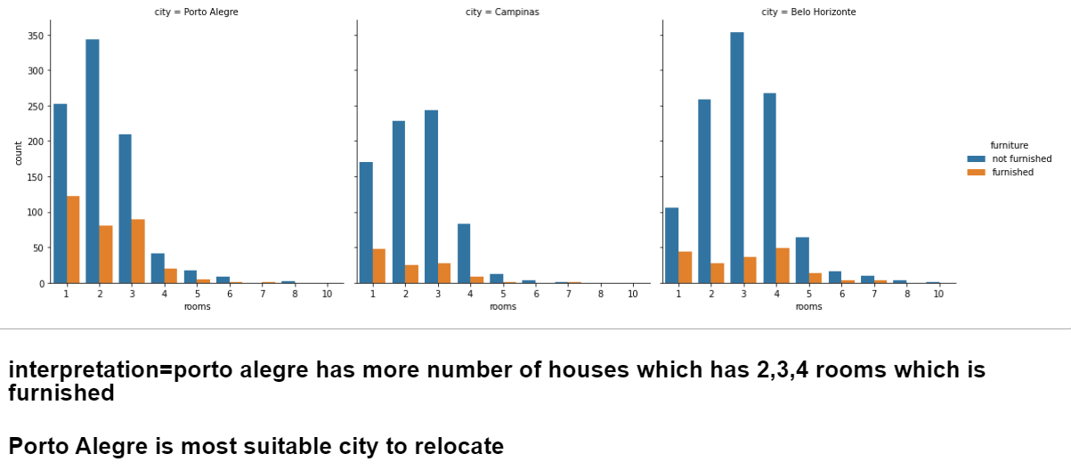
Columns=city to furniture

Slide 12
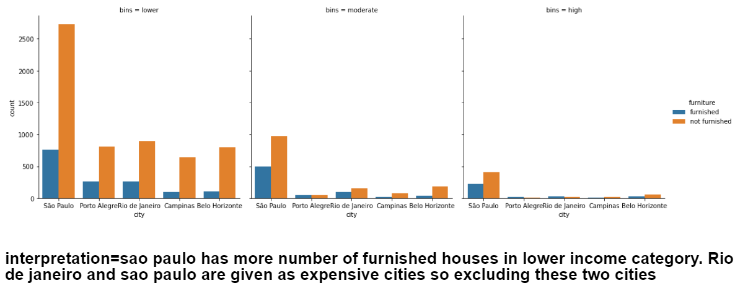
multivariet Columns=rentamount(R$),rooms,furniture

Slide 13
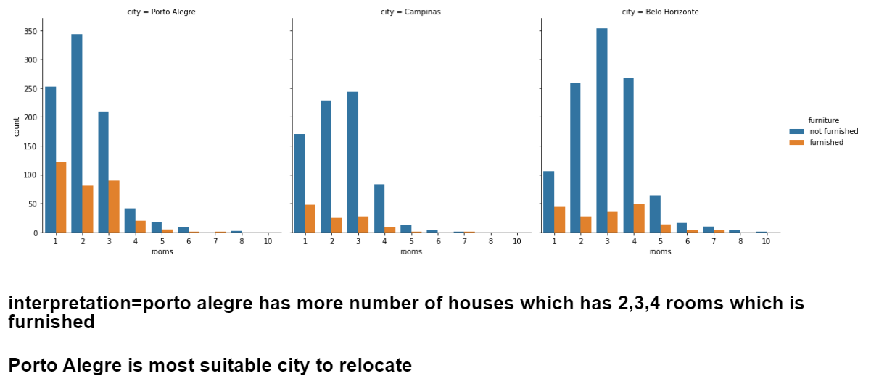
Columns=city,rooms,furniture

